Slide 1
Cdc42 controls spindle orientation to position the apical surface during epithelial morphogenesis
Aron B. Jaffe, Noriko Kaji, Joanne Durgan, and Alan Hall
JCB
Volume 183(4):625-633
November 17, 2008
© 2008 Jaffe et al.

Slide 2
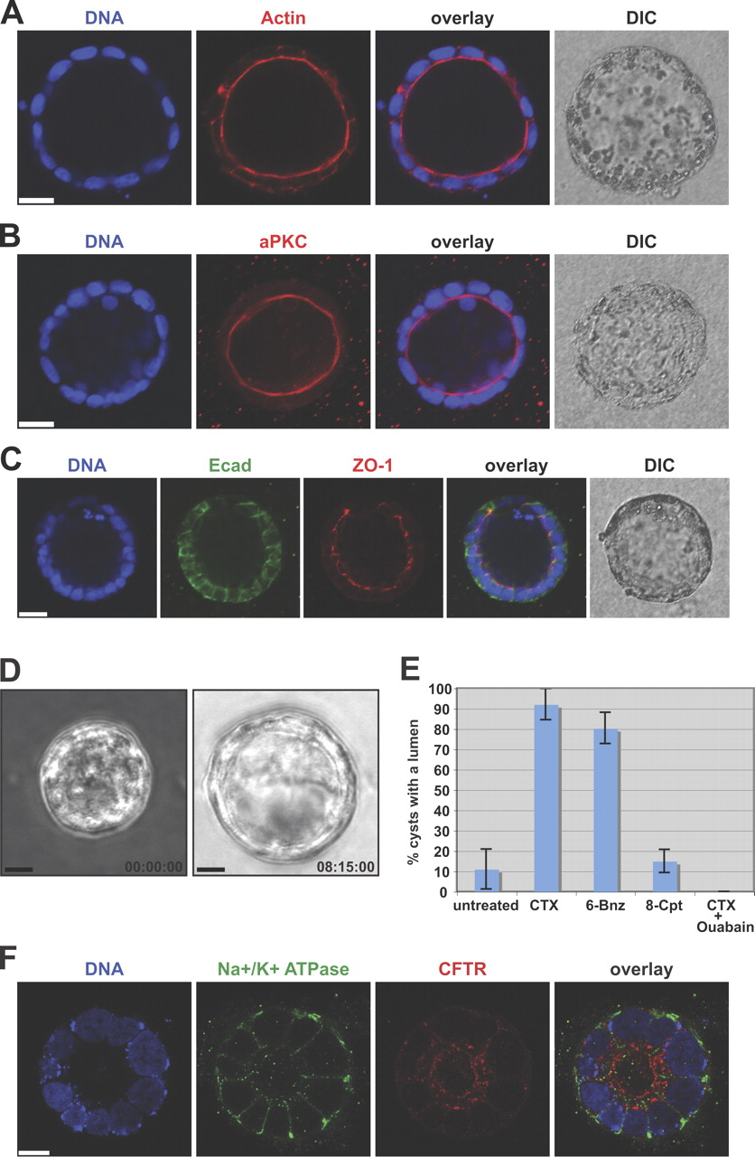
Caco-2 intestinal epithelial cells form polarized cysts in three dimensions.
Jaffe A et al. JCB 2008;183:625-633
© 2008 Jaffe et al.
Notes:
Caco-2 intestinal epithelial cells form polarized cysts in three dimensions. Caco-2 cells plated as a single-cell suspension in three dimensions were fixed and stained after 12 d. (A–C) Single confocal sections through the middle of cysts stained for DNA (blue) and actin (red; A); DNA (blue) and aPKC (red; B); and DNA (blue), E-cadherin (Ecad; green), and ZO-1 (red; C). Phase-contrast images (differential interference contrast [DIC]) are also shown. (D) Caco-2 plated as a single-cell suspension in three dimensions were cultured for 7 d and treated with 0.1 μg/ml CTX. Individual images shown from Video 2 (available at http://www.jcb.org/cgi/content/full/jcb.200807121/DC1) were taken at the indicated time points. (E) Lumen expansion in Caco-2 cells cultured as in D were treated with 0.1 μg/ml CTX, 100 μM of the PKA agonist 6-Bnz, 100 μM of the Epac agonist 8-Cpt, or 0.1 μg/ml CTX + 10 μM ouabain. Shown is the mean ± standard deviation for three independent experiments (50 cysts each). (F) Caco-2 was cultured for 10 d in three dimensions, fixed, and stained for DNA (blue), Na+/K+-ATPase (green), or CFTR (red). A single confocal section through the middle of the cyst is shown. Bars: (A–C) 25 μm; (D and F) 10 μm.

Slide 3
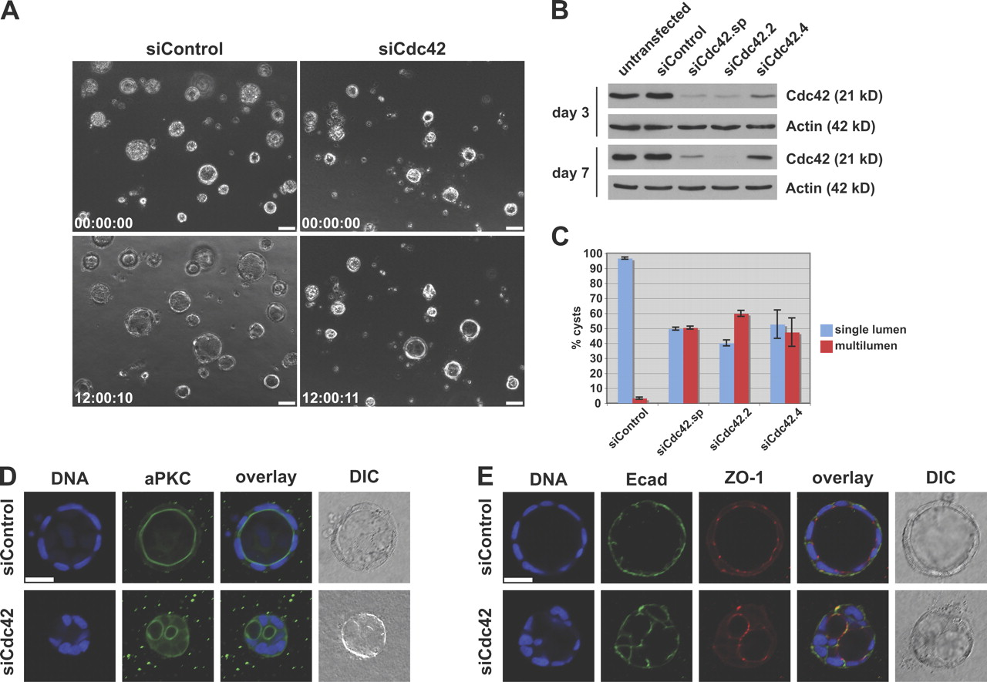
Cdc42 depletion induces multiple lumens.
Jaffe A et al. JCB 2008;183:625-633
© 2008 Jaffe et al.
Notes:
Cdc42 depletion induces multiple lumens. (A) Caco-2 was transfected with control or Cdc42 siRNA, plated in three dimensions, and treated with CTX at day 6 to induce luminal swelling. Phase images from cysts before (0 h) and after (12 h) treatment are shown. Note that about half of the Cdc42-depleted cysts lack a single central lumen. Bars, 50 μm. (B) Western blot of Caco-2 transfected with control siRNA, Cdc42 siRNA SMARTpool, or two different individual duplexes. Cdc42 levels are significantly reduced by 3 d and remain reduced for 7 d. (C) Caco-2 cultured as in A was fixed and stained with rhodamine phalloidin. Cysts were examined for single lumen (blue) or multiple lumens (red). The mean ± standard deviation for three independent experiments (at least 50 cysts each) is shown. (D and E) Caco-2 cultured as in A was fixed and stained for DNA (blue) and aPKC (green; D) or DNA (blue), E-cadherin (Ecad; green), and ZO-1 (red; E). Single confocal sections through the middle of the cysts are shown. DIC, differential interference contrast. Bars, 25 μm.

Slide 4
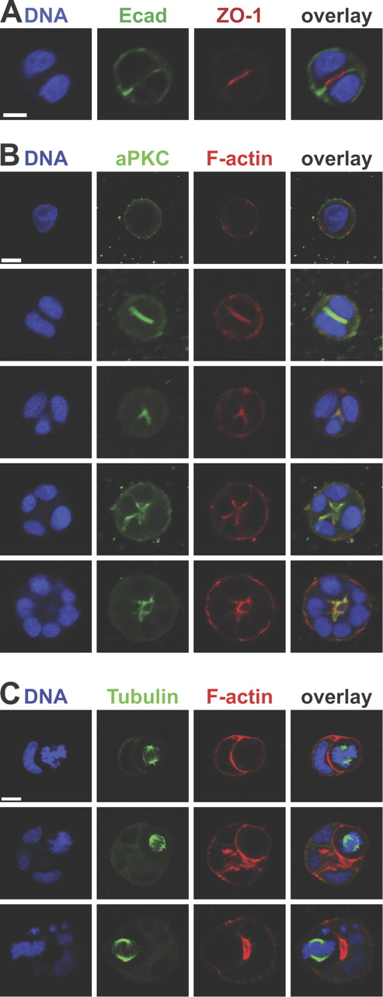
The apical surface is established at the first cell division and maintained at the center of the growing structure.
Jaffe A et al. JCB 2008;183:625-633
© 2008 Jaffe et al.
Notes:
The apical surface is established at the first cell division and maintained at the center of the growing structure. Cells were plated as a single-cell suspension in three dimensions, fixed, stained, and analyzed by confocal microscopy. (A) A two-cell structure stained for DNA (blue), E-cadherin (Ecad; green), and ZO-1 (red). A three-dimensional reconstruction of the structure is shown in Video 5 (available at http://www.jcb.org/cgi/content/full/jcb.200807121/DC1). Note that apical and basolateral membrane domains (defined by ZO-1 and E-cadherin, respectively) are segregated and readily visible. (B) Caco-2 structures at different stages of development were stained for DNA (blue), aPKC (green), and filamentous actin (F-actin; red). Note that single cells (top) are unpolarized in three dimensions, whereas apical polarity is readily observed in the two-cell structure (second row). (C) Caco-2 structures at different stages of development stained for DNA (blue), tubulin (green), and filamentous actin (red). Note that the mitotic spindle is oriented to produce daughter cells that preserve the spherical monolayered structure of the cyst. (A–C) Single confocal sections through the middle of each structure are shown. Bars, 10 μm.

Slide 5
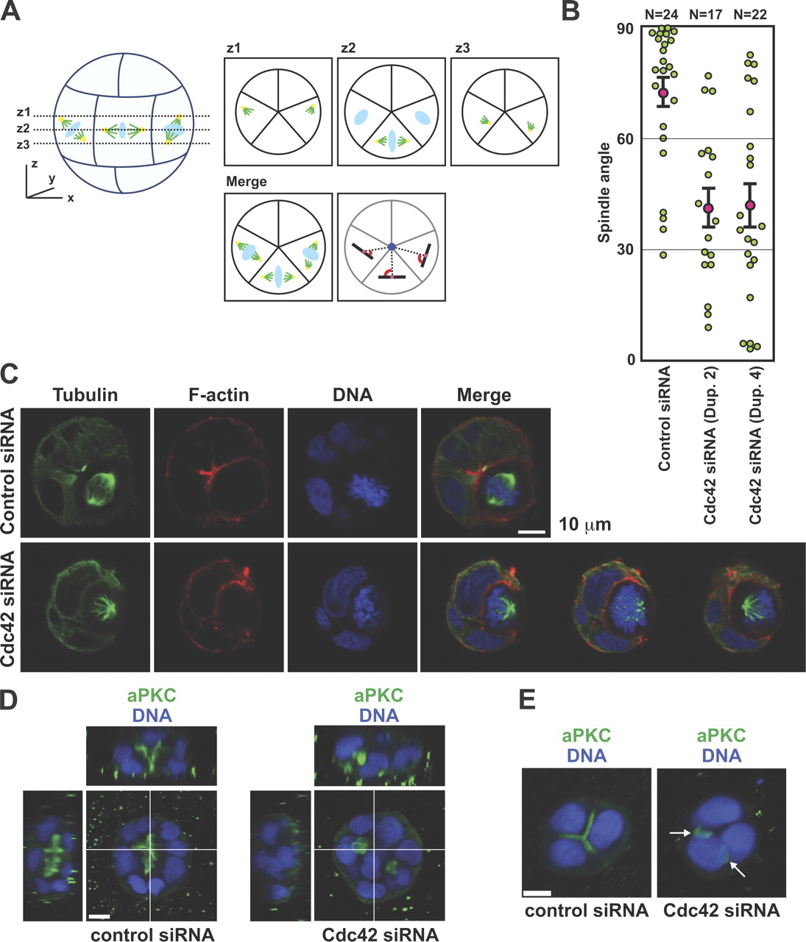
Cdc42 depletion disrupts mitotic spindle orientation.
Jaffe A et al. JCB 2008;183:625-633
© 2008 Jaffe et al.
Notes:
Cdc42 depletion disrupts mitotic spindle orientation. (A) Diagram depicting spindle angle measurement. The centroid of the cyst (dark blue circle) and the center of the spindle axis (pink circles) of a metaphase cell were drawn using ImageJ. The angle (red) between the spindle axis (black lines) and the line connecting the centroid of the cyst to the center of the spindle (dashed lines) was determined. To analyze spindle poles in different z sections, three z sections were taken so as to include both spindle poles and were merged as shown. Three schematic spindles are shown. The right and middle spindle examples represent correctly oriented spindles whose poles are positioned in one section (z2; middle spindle) or in different sections (z1 and z3; right spindle). The left spindle represents a misoriented spindle whose poles are in different z sections. Spindle microtubules, green; centrosomes, yellow; DNA, light blue. (B) Scatter diagram of metaphase spindle angles in cysts that were transfected with control or two Cdc42 siRNA duplexes from three independent experiments. Pink circles indicate mean values, green circles indicate individual data points, and error bars represent the SEM of the total number of spindles analyzed (N). (C) Caco-2 was transfected with control or Cdc42 siRNA and was fixed and stained for DNA (blue), tubulin (green), and filamentous actin (F-actin; red). Single confocal sections through the center of the cysts are shown. Three z sections are shown for the Cdc42 siRNA cyst to reveal both poles of the misoriented spindle. (D and E) Caco-2 transfected with control or Cdc42 siRNA was fixed and stained for DNA (blue) and aPKC (green). (D) Cdc42 siRNA structures contain cells in the middle, with apical domains present between inner and outer cells. (E) Cdc42 siRNA structures possess apical domains that are not in the center and single cells with more than one apical domain. Arrows indicate cells with multiple distinct apical patches on their surface. Bars, 10 μm.

Slide 6
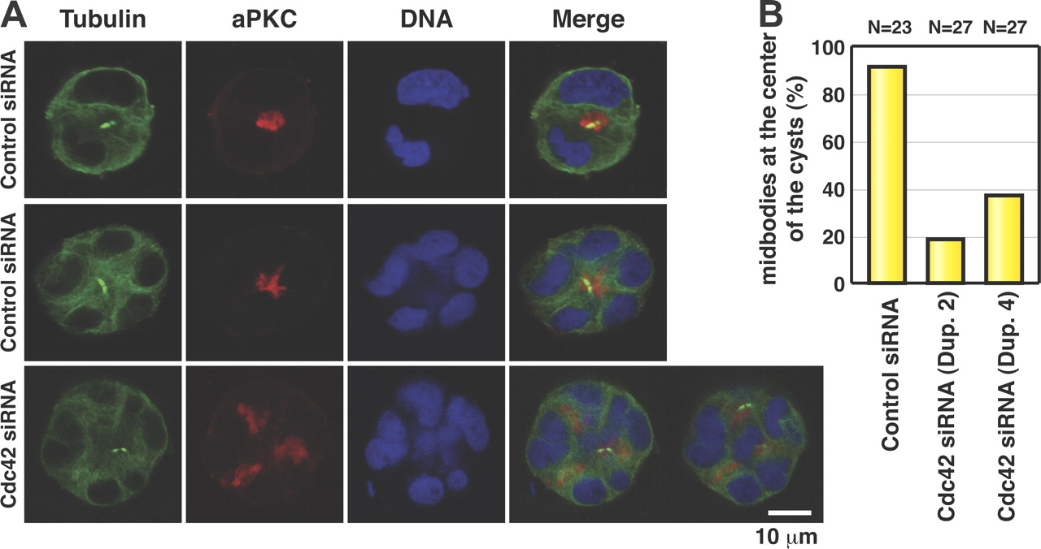
The midbody positions the apical surface during cyst development.
Jaffe A et al. JCB 2008;183:625-633
© 2008 Jaffe et al.
Notes:
The midbody positions the apical surface during cyst development. (A) Caco-2 transfected with control or Cdc42 siRNA was fixed and stained for DNA (blue), tubulin (green), and aPKC (red). (top) A control cyst at the two-cell stage (note that abscission appears to have occurred symmetrically). (middle) A larger control cyst, with the midbody in the center of the developing structure (apical region of dividing cell) reflecting asymmetric abscission. (bottom) Cdc42 siRNA structure with one midbody positioned normally at the center and another midbody (located in a different z section) abnormally positioned. (B) Quantitation of midbodies at the center of the cyst from three independent experiments. The total number of midbodies is indicated (N). A midbody is regarded as being in the center if it is located at a distance from the centroid that is less than one third the radius of the structure.

